Slide 1

Data structures using C
Module 6 - Lecture I
Graphs
Prepared By
Ms. Smriti Sehgal

Slide 2
Graph Terminology
Graph
Graph is a non linear data structure,
set of points known as nodes (or vertices)
set of links known as edges (or Arcs)
Graph is a collection of nodes and edges which connects nodes in the graph
Generally, a graph G is represented as
G = ( V , E )
where V is set of vertices and E is set of edges.

Slide 3

Example :
The following is a graph with 5 vertices and 7 edges.
This graph G can be defined as G = ( V , E ) Where V = {A,B,C,D,E} and
E ={(A,B),(A,C)(A,D),(B,D),(C,D),(B,E),(E,D)}.

Slide 4
Graph Terminology
1. Vertex : A individual data element of a graph is called as Vertex. Vertex is also known as node. In above example graph, A, B, C, D & E are known as vertices.
2. Edge: An edge is a connecting link between two vertices. Edge is also known as Arc. An edge is represented as (startingVertex, endingVertex).
Edges are of three types.
Undirected Edge : (A,B) is equal to edge (B,A). Bidirectional
Directed Edge : (A,B) is not equal to edge (B,A). Unidirectional
Weighted Edge - An edge with cost on it.

Slide 5
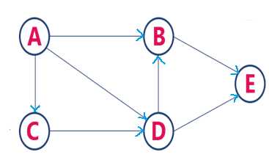
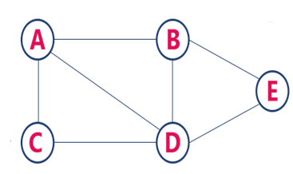
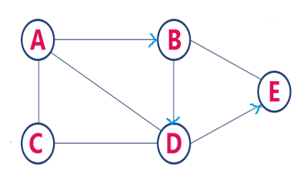
Graph Terminology cont.
3. Undirected Graph : A graph with only undirected edges
4. Directed Graph : A graph with only directed edges
5. Mixed Graph: A graph with undirected and directed edges
6. Source and Destination : If an edge is directed, its first endpoint is origin and the other endpoint is destination of the edge.
7. Incoming Edge & Outgoing Edge : A directed edge is said to be outgoing edge on its origin vertex and incoming edge on its destination vertex.
Source
Destination
8. Degree : Total number of edges connected to a vertex
In-degree & Out-degree ?
9. Path : A path is a sequence of alternating vertices and edges

Slide 6
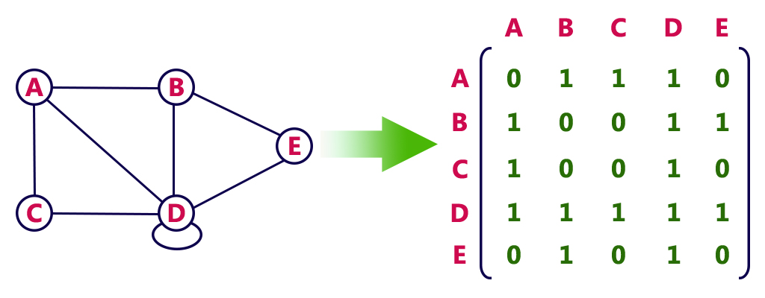
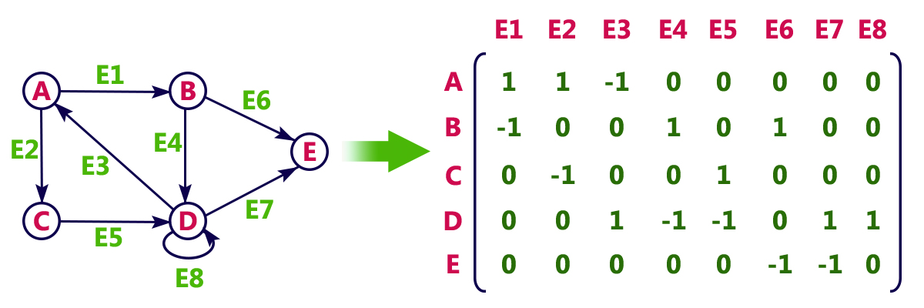
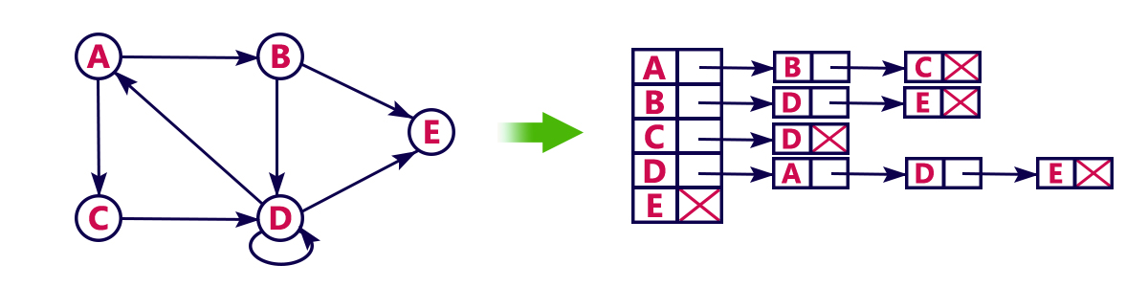
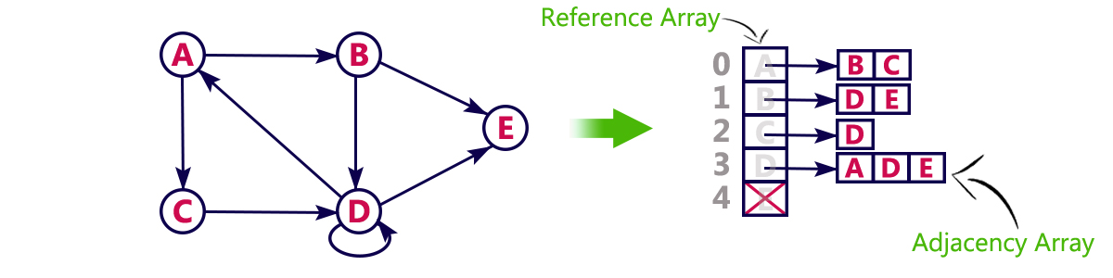
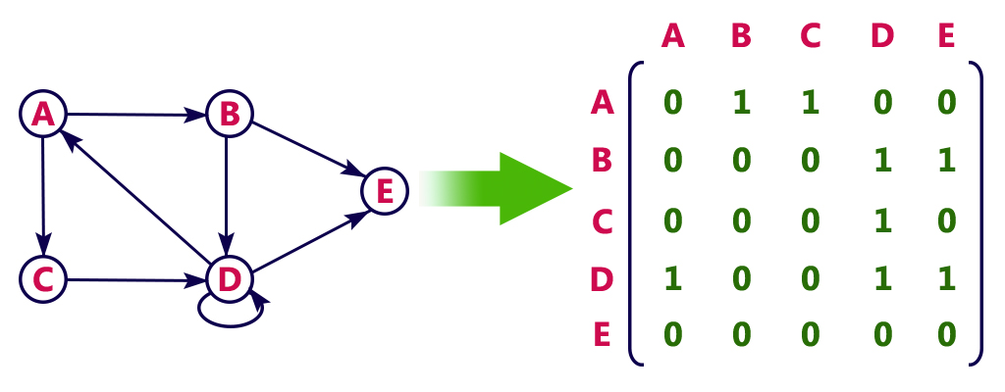
Graph Representations
Adjacency Matrix
In this representation, graph can be represented using a matrix of size V×V
Incidence Matrix
Adjacency List
In this representation, graph can be represented using a matrix of size V×E.
1. Using Linked List
2. Using array
This matrix is filled with either 0 or 1 or -1. Here, 0 represents row edge not connected to vertex, 1 as outgoing edge and -1 as incoming edge
It can take up to O(n) time to determine if a pair of nodes (A,B) is an edge
No matter how few edges the graph has, the matrix takes O(n²) in memory

Slide 7
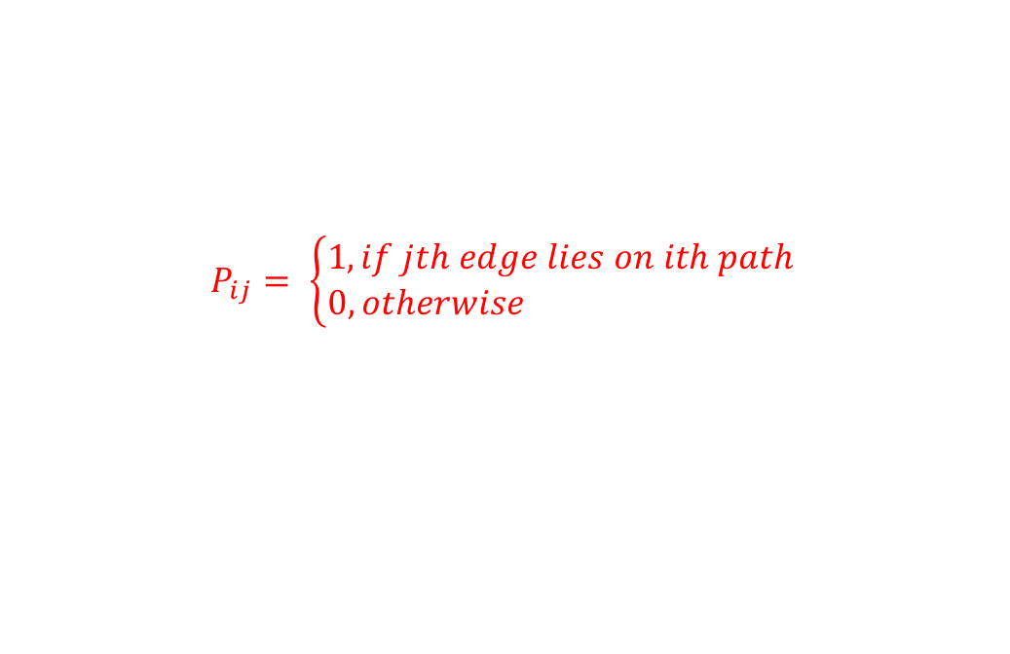
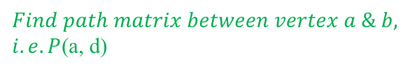

Module 6
PATH Matrix / Reachability Matrix
Graph Terminology
-Graph Representation
-Warshall Algorithms
If G is the simple graph with n-vertices & e –edges then the Path Matrix between V_{i} & V_{j} is denoted by P(V_{i} , V_{j}) or P_{ij}
-Different Operations on Graphs
-Graph Traversal
-Minimum
spanning tree
- Dijkstra shortest Path Algorithm
$$P_{ij}= \left\{\begin{aligned}1, if jth edge lies on ith path \\ 0, otherwise \end{aligned}\right.$$
a
e₁
b
We consider all possible path between a & d
$$\text{Example}$$
e₂
P(a, d) =
e₅
e₆
e₁
e₂
e₃
e₄
e₅
e₆
e₇
e₇
c
(1). {e₁ , e₇}
1
0
0
0
0
0
1
e₃
(2). {e₁ , e₆, e₄}
1
0
0
1
0
1
0
e
e₄
d
(3). {e₁ , e₂, e₃}
1
1
1
0
0
0
0
$Find path matrix between vertex a \& b, i.e. P$(a, d)
(4). {e₅ , e₆, e₇}
0
0
0
0
1
1
1
(5). {e₅ , e₄}
0
0
0
1
1
0
0

Slide 8
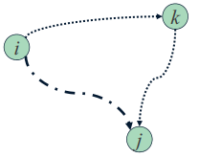
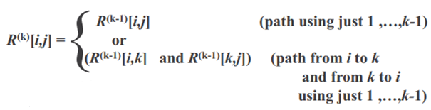
Warshall’s Algorithm
Main idea: Main idea: a path exists between two vertices i, j, iff
there is an edge from i to j; or
there is a path from i to j going through vertex 1; or
there is a path from i to j going through vertex 1 and/or 2; or
…
there is a path from i to j going through any of the other vertices
On the k^{th} iteration, the algorithm determine if a path exists between two vertices i, j using just vertices among 1,…,k allowed as intermediate

Slide 9
Pseudo code for Warshall’s Algorithm
Create a Adjacency Matrix
Repeat for I, j = 1, 2, …, n // initialize p
if (A[i,j] = 0 then p[i, j]=0)
else p[i, j]=1 // End of loop
// Update p
2. Repeat for k = 1, 2, …, n
Repeat for i = 1, 2, …, n
Repeat for j = 1, 2, …, n
p[i, j] = p[i, j] or (p[ i,k] and p[k, j])
Exit
Time efficiency: $θ$(n³)
Space efficiency: Matrices can be written over their predecessors

Slide 10
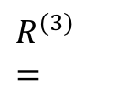
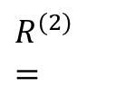
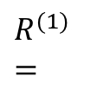
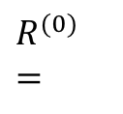

Warshall’s Algorithm cont’d
$$R^{(1)}=$$
 | 1 | 2 | 3 | 4 | 5
1
2
3
4
5
0
1
1
0
0
0
0
0
1
1
0
0
0
1
0
1
0
1
1
1
0
0
0
0
0
$$R^{(2)}=$$
 | 1 | 2 | 3 | 4 | 5
1
2
3
4
5
Find the path matrix for the above graph
0
1
1
1
1
p[i, j] = p[i, j] or (p[i,k] and p[k, j])
Or
$$R^{(1)}\left[i, j\right]=R^{\left(0\right)}\left[i, j\right]or{(R}^{\left(0\right)}\left[i, k\right]andR^{\left(0\right)}\left[k, j\right]$$
0
0
0
1
1
0
0
0
1
0
1
0
1
1
1
0
0
0
0
0
$$R^{(0)}=$$
 | A/1 | B/2 | C/3 | D/4 | E/5
A/1
B/2
C/3
D/4
E/5
$$R^{(3)}=$$
 | 1 | 2 | 3 | 4 | 5
1
2
3
4
5
0
1
1
0
0
0
1
1
1
0
0
0
0
1
1
0
0
0
1
1
0
0
0
1
0
0
0
0
1
0
1
0
0
1
1
1
0
1
1
1
0
0
0
0
0
0
0
0
0
0

Slide 11
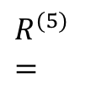
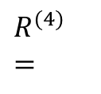
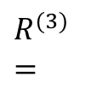
Warshall’s Algorithm cont’d
$$R^{(4)}=$$
 | 1 | 2 | 3 | 4 | 5
1
2
3
4
5
1
1
1
1
1
1
0
1
1
1
1
0
1
1
1
1
0
1
1
1
0
0
0
0
0
$$R^{(5)}=$$
 | 1 | 2 | 3 | 4 | 5
1
2
3
4
5
Find the path matrix for the above graph
1
1
1
1
1
p[i, j] = p[i, j] or (p[i,k] and p[k, j])
Or
$$R^{(1)}\left[i, j\right]=R^{\left(0\right)}\left[i, j\right]or{(R}^{\left(0\right)}\left[i, k\right]andR^{\left(0\right)}\left[k, j\right]$$
1
0
1
1
1
1
0
1
1
0
1
0
1
1
1
$$R^{(3)}=$$
0
0
0
0
0
 | 1 | 2 | 3 | 4 | 5
1
2
3
4
5
0
1
1
1
0
This is the final path matrix
0
0
0
1
1
0
0
0
1
0
1
0
1
1
1
0
0
0
0
0

Slide 12
Exercise
F
C
A
B
D
H
G
E
Find the path matrix for the above graph

Slide 13
Topological Sorting
an ordering of the vertices in a directed acyclic graph, such that: If there is a path from u to v, then v appears after u in the ordering.
Conditions for Topological ordering
The graphs should be directed
The graphs should be acyclic
Example :
V1
V2
V3
V1
V2
V3
V4
&
V1
V3
V2
V4
V4

Slide 14
How to sort
The algorithm for topological sort uses "indegrees" of vertices.
Indegree of vertex: no.of incoming edges
Algorithm
1. Compute the indegrees of all vertices
2. Find a vertex U with indegree 0 and print it (store it in the ordering) If there is no such vertex then there is a cycle and the vertices cannot be ordered. Stop.
3. Remove U and all its edges (U,V) from the graph.
4. Update the indegrees of the remaining vertices.
5. Repeat steps 2 through 4 while there are vertices to be processed.

Slide 15
Example
V1
V2
V1: 0
1. Compute the indegrees:
V2: 1
V3: 2
V3
V4
V5
V4: 2
V5: 2
 | Indegree
Sorted
V1
V2
V3
V4
V5
2. Find a vertex with indegree 0:
V1
V1
V1,V2
V1,V2,V4
V1,V2,V4,V3
V1,V2,V4,V3,V5
0
3. Output V1 , remove V1, so all the edges from V1 will also be deleted, Now again update the indegrees
1
0
2
1
1
0
4. Follow step 2&3 till all vertex is removed.
2
1
0
Note: both V3 & V5 now have same indegree, here you can choose randomly any one.
2
2
1
0
0

Slide 16
Complexity Analysis
Complexity of this algorithm: O(|V|²),
To find a vertex of indegree 0 we scan all the vertices- |V| operations.
We do this for all vertices so |V|²

Slide 17
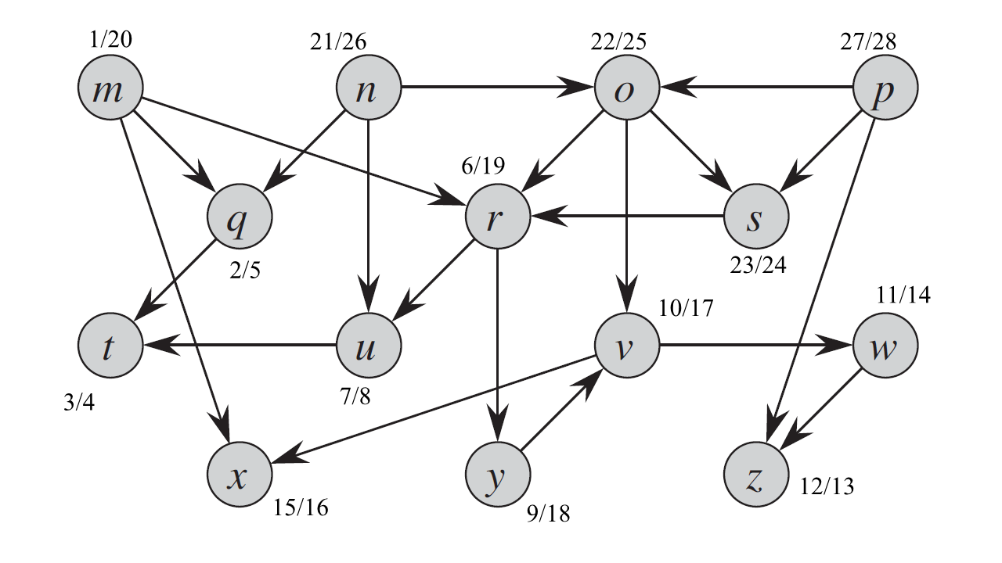
Exercise

Slide 18


